Slide 1
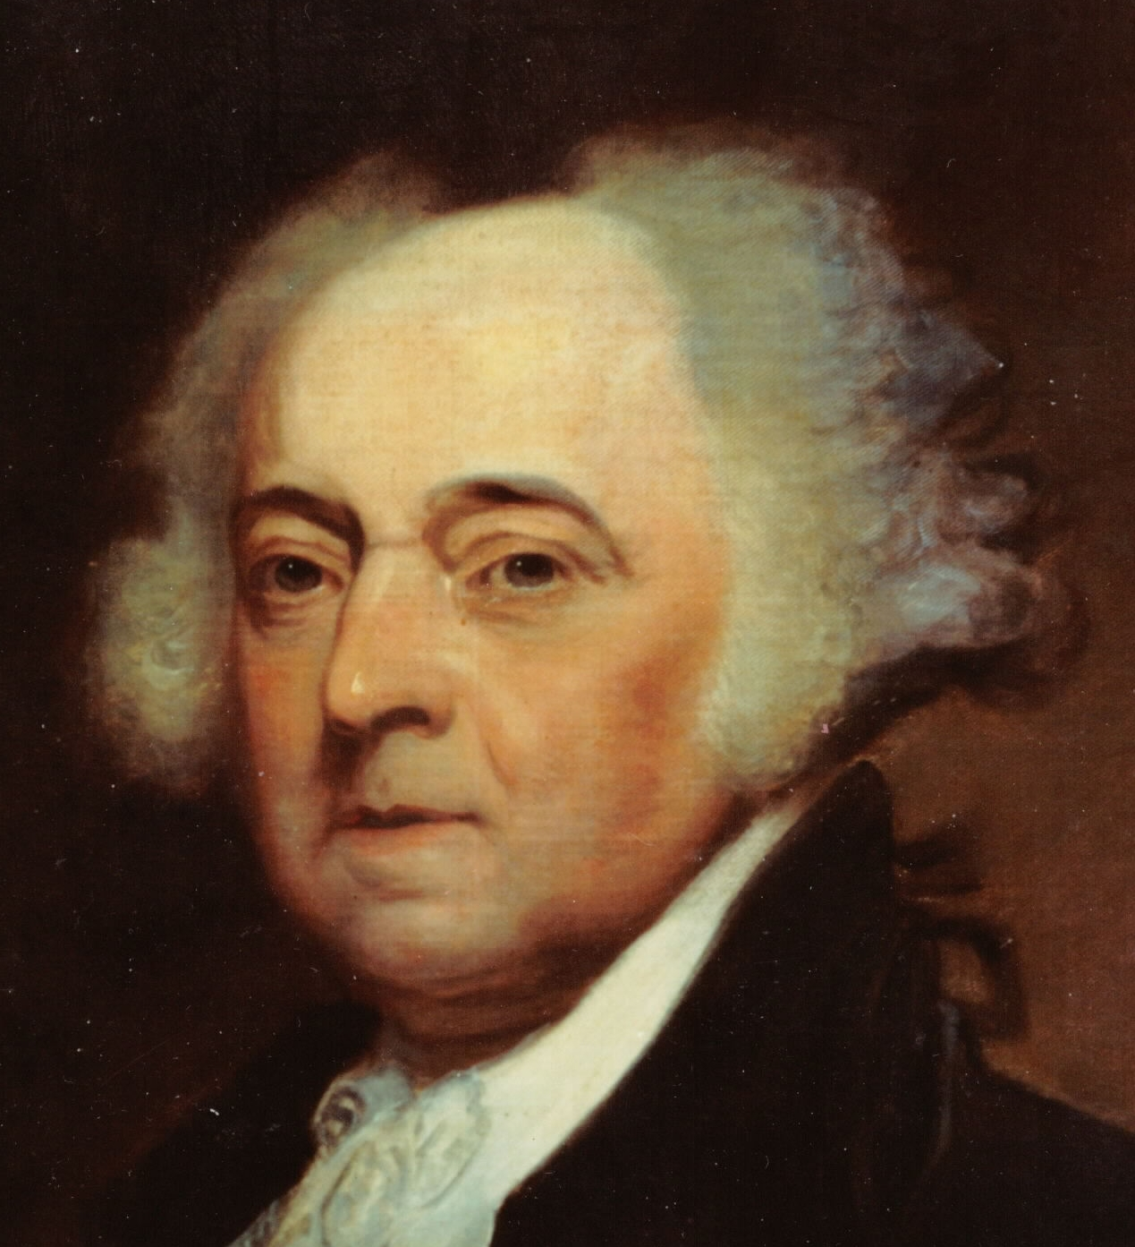
John Adams
A Guy Who Was President

Slide 2
Targets

Slide 3
Questions to Ponder
To what extent were the Alien and Sedition Acts a violation of the Bill of Rights?
How did the Federalist party justify the need for the acts?
How did they affect the growth of the Republican party?
Were the Virginia and Kentucky Resolutions opposed to the restriction of rights under the Alien & Sedition Acts or were they concerned about the nature of federalism?

Slide 4
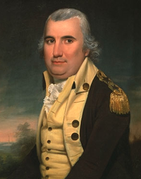
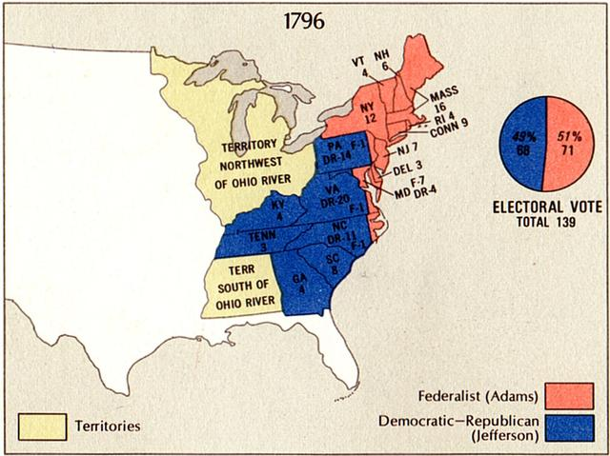
Election of 1796
Each elector cast two votes; the person with the most votes was Pres., second most,VP
Hamilton tried to get Pinckney elected by obtaining the second vote from both Federalists and Republicans→ failed
→Adams receives Pres, Jefferson VP
Pinckney?!

Slide 5
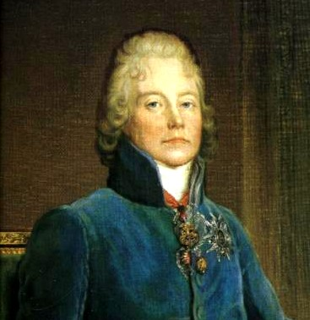
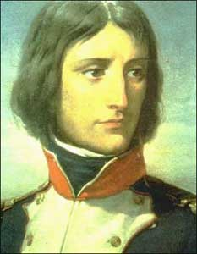
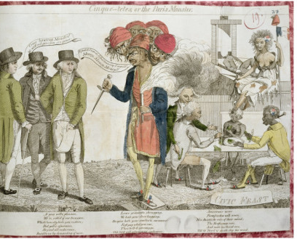
XYZ Affair
Adams send US envoy of Marshall, Pinckney and Gerry to France to negotiate end to French impressment of US sailors
Talleyrand, French Foreign Minister tried to bribe→
Press picks up story, and US demands war against France→
Undeclared sea war for two years→ est. US Navy (1798)
Adams refused to bend to party politics by declaring war, instead he sent Murray to negotiate a new treaty with France to agree to free trade and end to hostilities→ Napoleon now in charge so ready to negotiate to set up allies against Britain
Tallyrand
Napoleon

Slide 6


Alien & Sedition Acts
Alien Acts (June-July 1798)
Alien Enemies Act – Restraint of enemy aliens during wartime
Naturalization Act – Citizenship takes 14 years (aimed at Republican party b/c most immigrants joined it)
Alien Friends Act – (for 2 years only) President power to deport any alien he considers dangerous
Sedition Act (July 1798) – fines and imprisonment to people who opposed the govt.; expire when new president comes into office
Virginia Resolution (Madison) and Kentucky Resolution (Jefferson) – state the authority of the state govs to rule the Alien and Sedition Acts unconstitutional and accd to Kentucky Res null and void→ not enforced, but raised the issue of central vs. state gov as supreme law of land
X

Slide 7
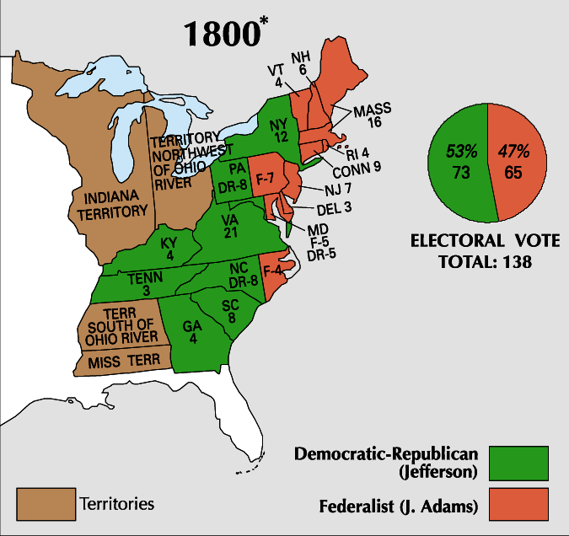
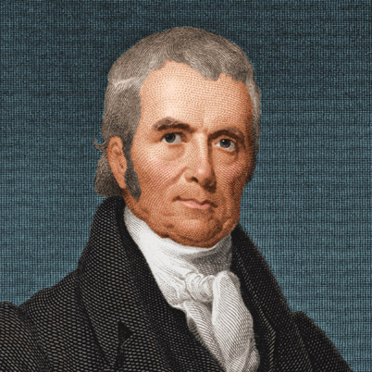
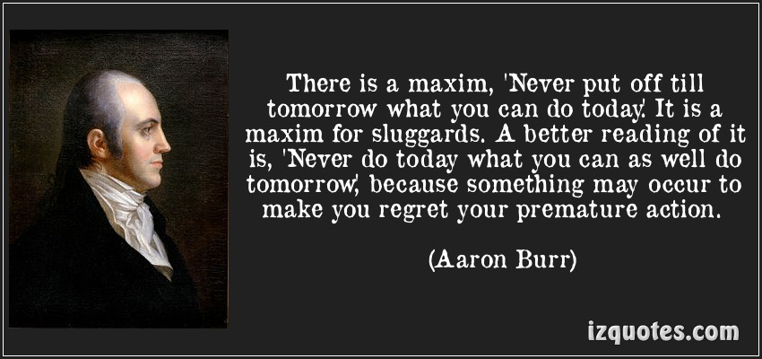
Election of 1800
Adams denounced High Federalists too late; lost by 8!
Jefferson and Burr tie (73 EVs)→tie broken in House
tie couldn't be broken for a week (some Reps cast blank ballots and Jefferson won necessary nine states; Burr →VP
12th Amendment – voting separate for Pres. and VP.
Meanwhile…Adams – Secures Federalist position in judiciary for decades by appointed “midnight judges”; John Marshall as chief justice
Marshall

